Slide 1
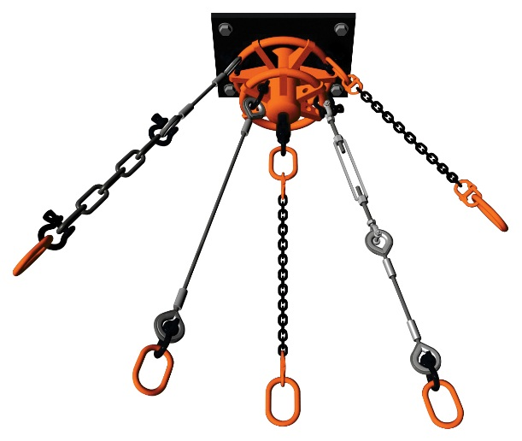
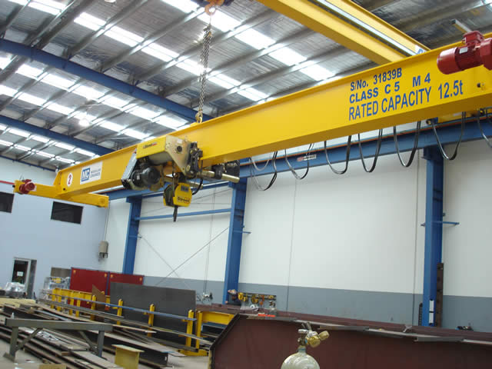
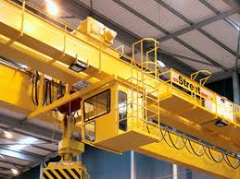
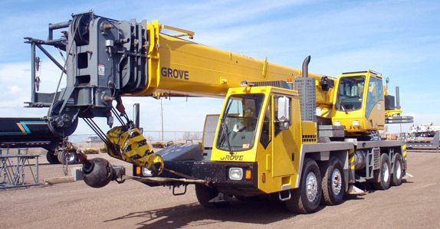
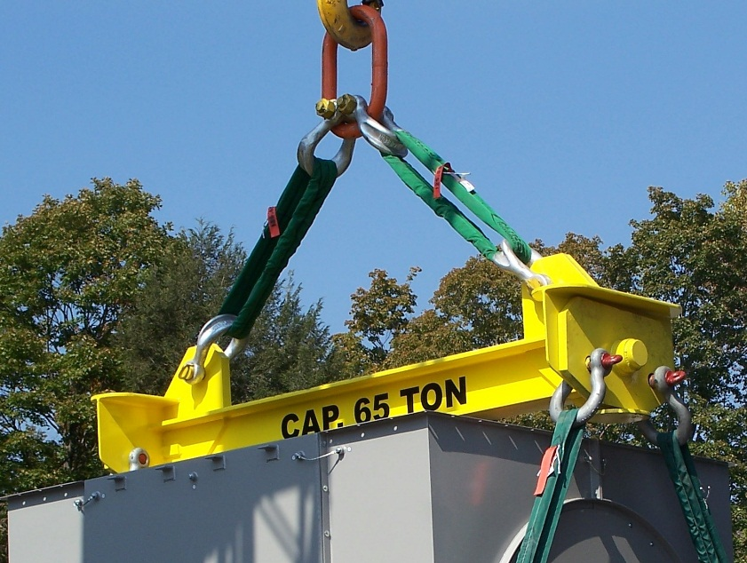
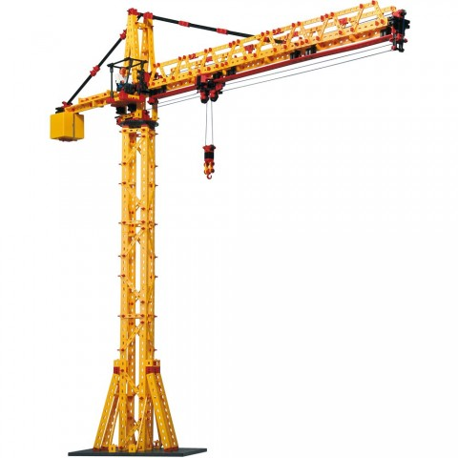
CRANES & RIGGING
Presented by:
Kurt Rayburg, CSP, CPEA
Safety Manager - CURI

Slide 2
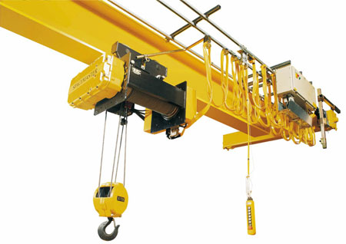
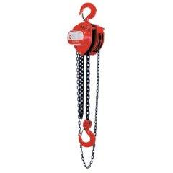
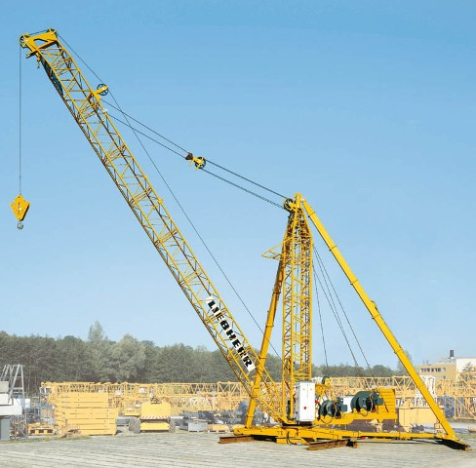
Terminology
Crane – a machine for lifting and lowering a load and moving it horizontally, with the hoisting mechanism. Cranes are driven manually or by power.
Derrick – an apparatus consisting of a mast held at the head by guys or braces, with or without a boom, for use with a hoisting mechanism and operating ropes.

Slide 3
Terminology
Certified Operator – a person who has successfully completed a training curriculum from an accredited crane operator testing program. (Crane Institute/NCCCO)
Qualified Person – a person who, by possession of a recognized degree, certificate or professional standing, or by extensive training, knowledge and experience, successfully demonstrates the ability to solve or resolve issues related to a subject matter.
Competent Person – a person who is capable of identifying existing and predictable hazards and has the authority to take corrective action.

Slide 4
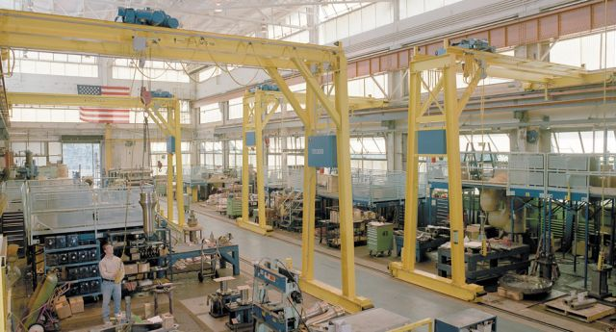
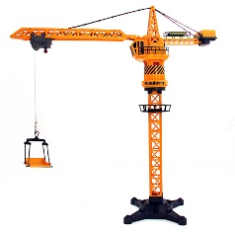
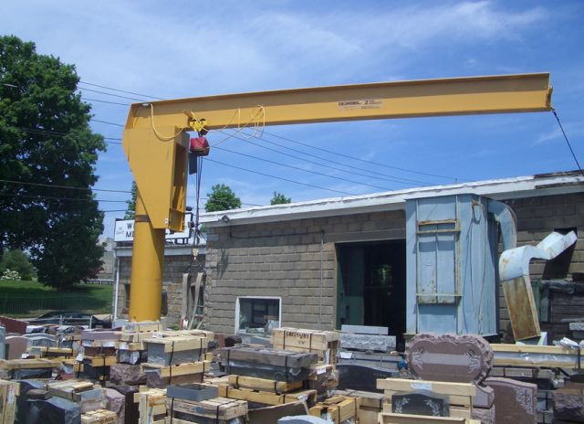
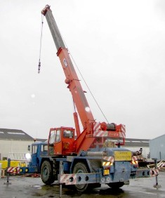
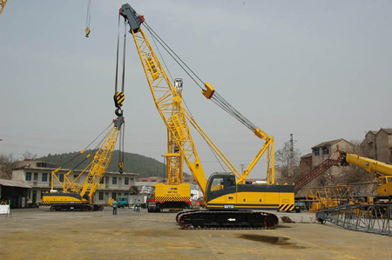
Types of Cranes
Crawler
Gantry
Tower
Mobile
Overhead
Jib

Slide 5
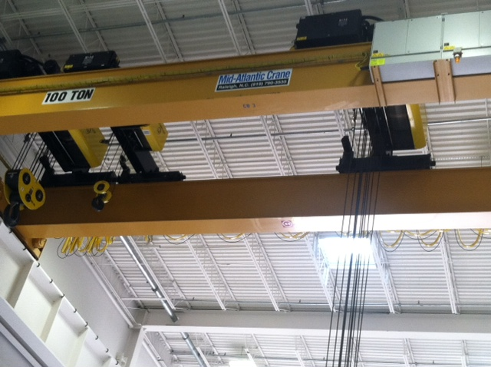
CURI Cranes

Slide 6
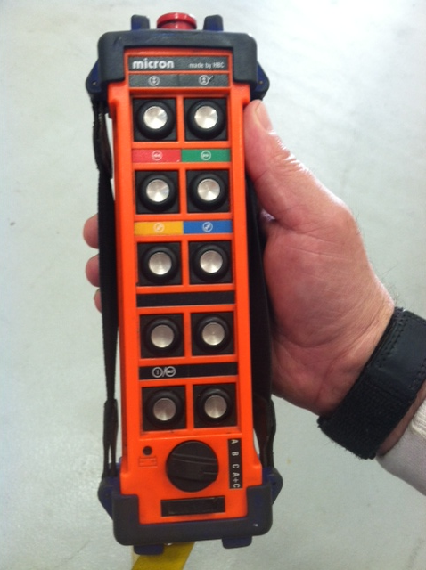
Crane Compass

Slide 7
Training
OSHA has a deadline for crane operators certification to November 10th, 2018. (Construction Standard)
Testing agencies must be accredited by a nationally recognized accrediting agency based on criteria for;
- Written and practical exams
- Testing materials / grading
- Facilities and equipment
Industrial 1910.179(b)(8)
- Only designated personnel shall be permitted to operate a crane.

Slide 8
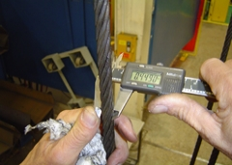
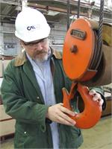
Crane Inspections
Each Shift - Competent person must inspect prior to each shift (use).
Monthly – Competent person must document monthly inspection and retain for 3 months.
Annual - Qualified person must inspect, disassemble and functionally test. Retain document for 1 year
*Certification training includes inspection techniques.

Slide 9
Operational Inspection
Move crane several feet in each direction
Unusual noises and jerky movements
Control station and switches work correctly
Lower hoist block to make sure at least 2 turns of rope remain on drum
Hook has a safety latch and it’s not stretched.

Slide 10
Visual Inspection
Look for crane tags
Look for physical damage
Check hoist chain and wire rope
Make sure wire rope is seated in drum and sheave grooves
Look for disconnect switch.

Slide 11
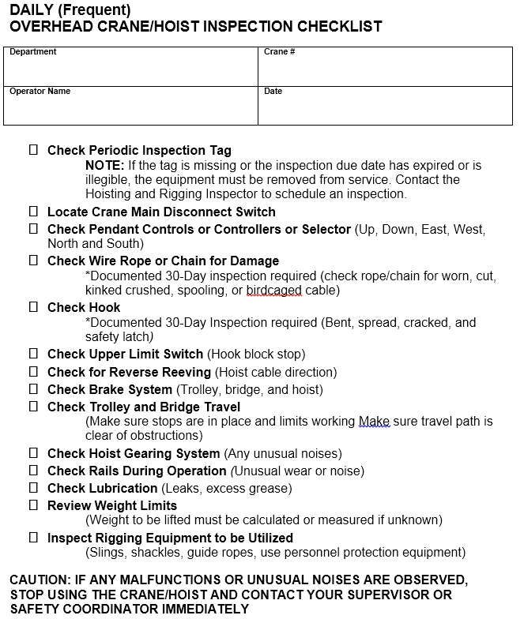

Slide 12
Rigging – What We Need To Know
Employers must ensure:
1) inspection prior to use
2) permanent markings are affixed showing safe working load
3) not to be loaded in excess of working load
4) not to be used without affixed markings
5) when not in use, removed from working area

Slide 13
GEARBOX RIGGING

Slide 14
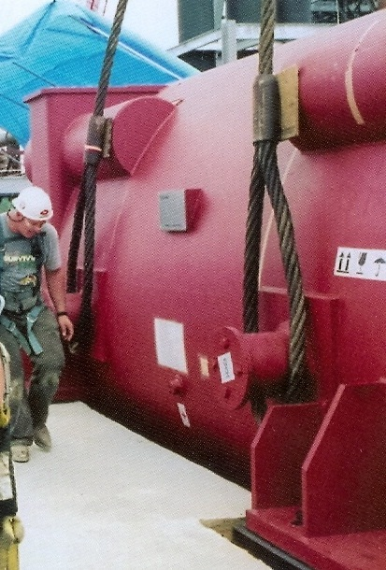
Rigging Considerations
POSITIVE CONNECTION
ROTATION
EQUALIZATION
CENTER OF GRAVITY

Slide 15
Rigging Equipment Slings
Types of slings covered are those made from alloy steel chain, wire rope, metal mesh, natural or synthetic fiber rope, and synthetic web.
Chain
Wire rope
Metal mesh
Synthetic

Slide 16
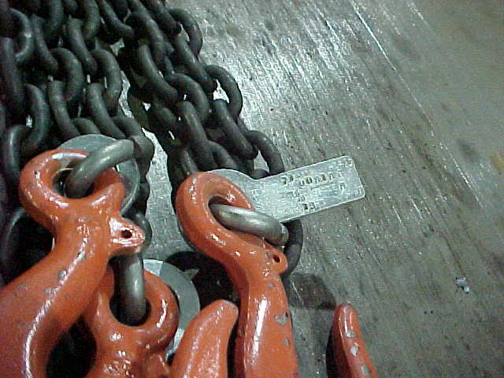
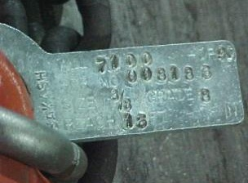
Alloy Steel Chains
Adapts to shape of the load
Can be damage by sudden shocks
Best choice for hoisting very hot materials
Must have an affixed tag stating size, grade, rated capacity, and sling manufacturer

Slide 17
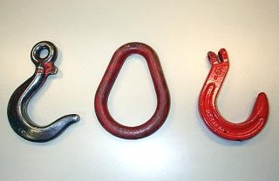
Alloy Steel Chain Attachments
Rated Capacity
Hooks, rings, oblong links, or other attachments, when used with alloy steel chains, must have a rated capacity at least equal to that of the chain

Slide 18
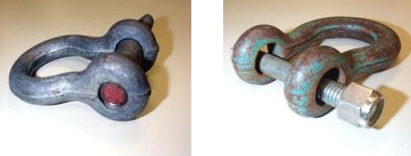
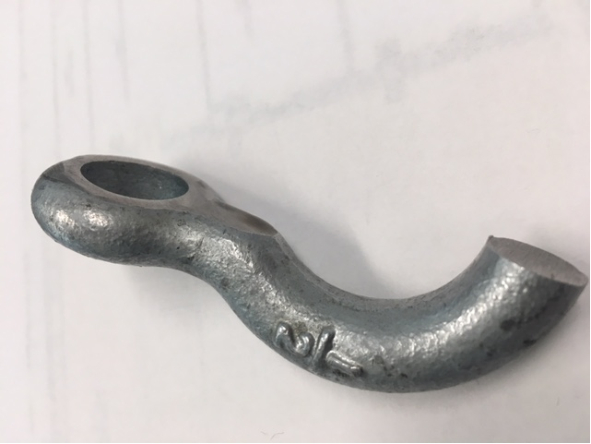
Unsuitable Alloy Steel Chain Attachments
Right
Wrong
Job or shop hooks and links, or makeshift fasteners, formed from bolts, rods, etc., or other altered attachments, can’t be used

Slide 19
Wire Rope Slings
Wire
Used to hoist materials
Selection considerations:
strength
ability to bend without cracking
ability to withstand abrasive wear
ability to withstand abuse
Core
Center
Strand
Wire rope

Slide 20
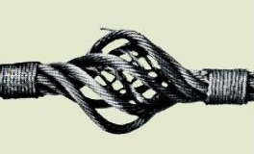
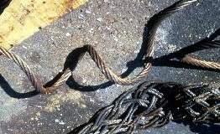
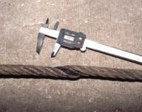
Wire Rope Slings Cont.
If these happen, remove the wire rope sling from service
Bird Caging
Kinking
Crushing

Slide 21
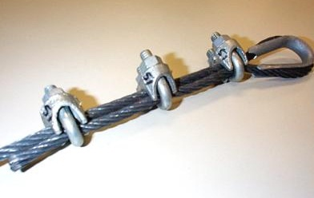
Wire Rope Clips
When using U-bolt wire rope clips to form eyes, ensure the "U" section is in contact with the dead end of the rope
This is the correct method

Slide 22
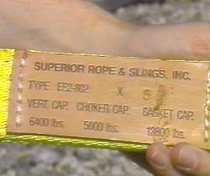
Synthetic Web Sling Markings
Mark or code to show:
Name or trademark of manufacturer
Rated capacities for the type of hitch
Type of material

Slide 23
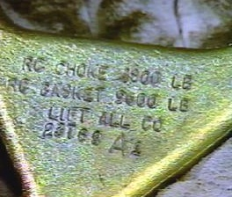
Synthetic Web Slings Fittings
Fittings must be:
At least as strong as that of the sling
Free of sharp edges that could damage the webbing

Slide 24
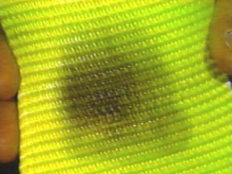
Synthetic Web Slings - Remove from Service
Remove from service if any of these are present:
Acid or caustic burns
Melting or charring of any part
Snags, punctures, tears or cuts
Broken or worn stitches
Distortion of fittings
Heat Damage

Slide 25
Lifting and Moving
Make sure hands are clear of potential pinch points
No one is positioned between load and another object
Slowly raise hoist block to remove slack
Slings are fully seated
Lift load a few inches to check rigging
Lift load high enough to clear obstructions.

Slide 26
Don’ts
Jog controls unnecessarily
Use pendant control station to swing jib boom into place
Leave suspended load unattended
Pass load over people or allow anyone to walk under it.
Pull a load
Get distracted
Allow unused slings or ropes to remain on the hook
Leave hoist block low enough to hit someone.

Slide 27
BASIC HITCHES Load Angle Factor
60 degree angle
45 degree angle
L
577 lbs.
H
707 lbs.
1000 lbs.
1000 lbs.
30 degree angle
10 degree
angle
1000 lbs.
2874 lbs.
1000 lbs.
1000 lbs.

Slide 28
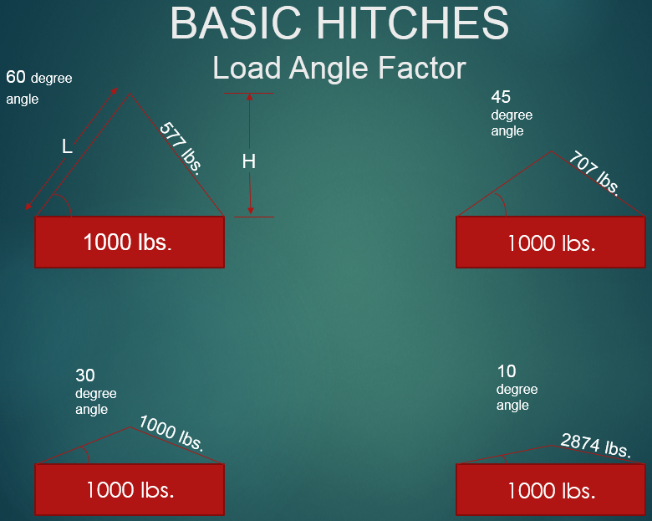
Calculation vs LAF Table
Sling Angle | LAF
90 | 1.000
60 | 1.155
45 | 1.414
30 | 2.000
20 | 2.924
10 | 5.747
5 | 11.49
Danger
L/H = LAF
LAF X Load weight = Total Stress
Total Stress x Load Weight Distribution = Stress Per Leg

Slide 29
Signalperson
Signalperson must be qualified by 3rd party or employer qualified evaluator
Qualification requirements are:
- know and understand the types of signals used and be competent in their use
- have basic understanding of equipment operation and limitations
- demonstrate they meet above requirements through written and oral test

Slide 30
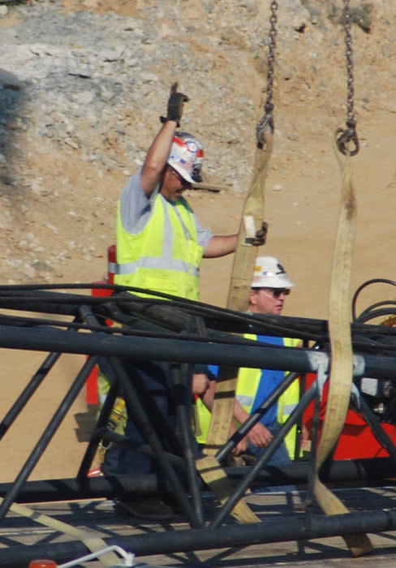
Signalperson
When signalperson is needed:
- the load travel / placement area is not in full view
- the view in the direction of travel is obstructed
- either operator or load handler determines it is necessary

Slide 31
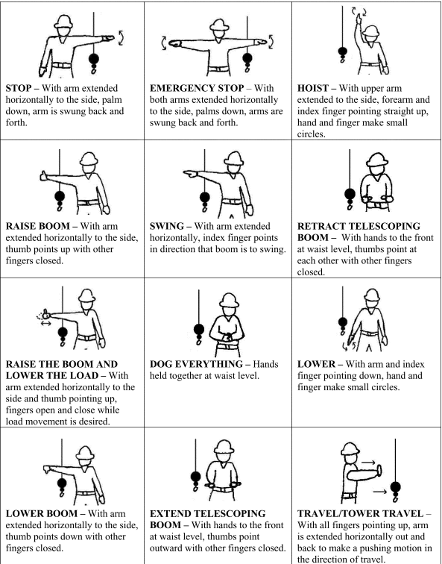
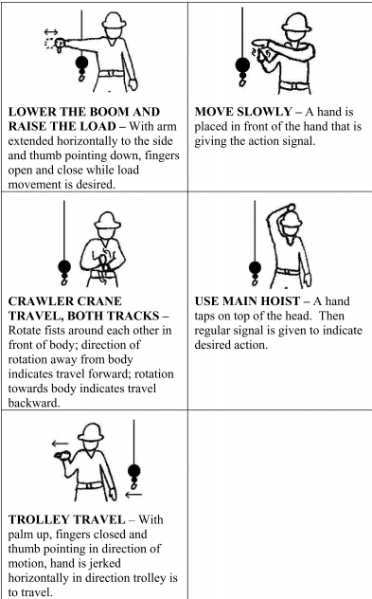

Slide 32
EXAM QUESTION # 1
Under the new crane standard, you must be certified by an accredited program before you are able to use a crane? (Here at CURI)
a) Absolutely
b) Designated operators can operate cranes in industrial operations
c) Experience and past knowledge will exempt the requirement
d) Certification cards can be purchased online to show certification

Slide 33
EXAM QUESTION # 1
Under the new crane standard, you must be certified by an accredited program before you are able to use a crane? (Here at CURI)
a) Absolutely
b) Designated operators can operate cranes in industrial operations
c) Experience and past knowledge will exempt the requirement
d) Certification cards can be purchased online to show certification

Slide 34
EXAM QUESTION # 2
Rigging equipment must be inspected how often?
a) Prior to each shift
b) Once Daily
c) prior to use on each shift and as necessary during the use to ensure that it is safe
d) Before quitting time

Slide 35
EXAM QUESTION # 2
Rigging equipment must be inspected how often?
a) Prior to each shift
b) Once Daily
c) prior to use on each shift and as necessary during the use to ensure that it is safe
d) Before quitting time

Slide 36
EXAM QUESTION # 3
Who must perform inspections on slings?
a) Anyone with knowledge and training
b) Only trained supervisors
c) A competent person
d) Only iron workers

Slide 37
EXAM QUESTION # 3
Who must perform inspections on slings?
a) Anyone with knowledge and training
b) Only trained supervisors
c) A competent person
d) Only iron workers

Slide 38
EXAM QUESTION # 4
When using U-bolt wire rope clips to form eyes, ensure the "U" section is in contact with the __________ of the rope?
a) Live end
b) Dead end
c) Both ends
d) No ends

Slide 39
EXAM QUESTION # 4
When using U-bolt wire rope clips to form eyes, ensure the "U" section is in contact with the __________ of the rope?
a) Live end
b) Dead end
c) Both ends
d) No ends

Slide 40
EXAM QUESTION # 5
Operators using cranes, derricks and chain falls < 1 ton need not to be trained in the proper operation and hazards?
a) True
b) False

Slide 41
EXAM QUESTION # 5
Operators using cranes, derricks and chain falls < 1 ton need not to be trained in the proper operation and hazards?
a) True
b) False

Slide 42
EXAM QUESTION # 6
A signalperson is needed when the load placement location is obstructed or not in full view?
a) True
b) False

Slide 43
EXAM QUESTION # 6
A signalperson is needed when the load placement location is obstructed or not in full view?
a) True
b) False

Slide 44
QUESTIONS?

